Slide 1
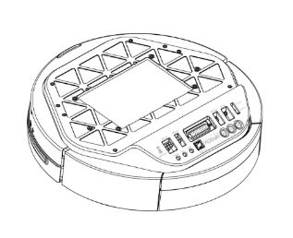
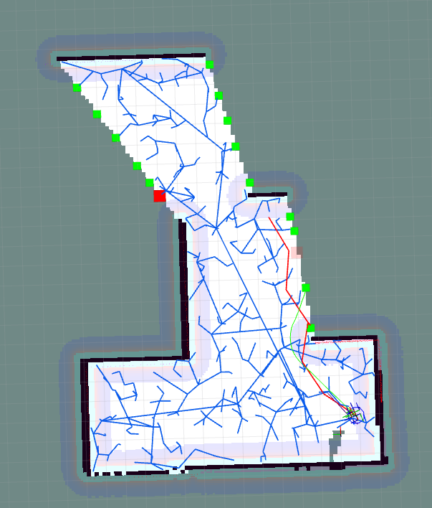
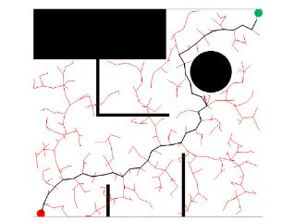

RRT-SLAM for Motion Planning
Govind Ajith Kumar 116699488
Markose Jacob 117000269
Rajeshwar NS 116921237

Slide 2
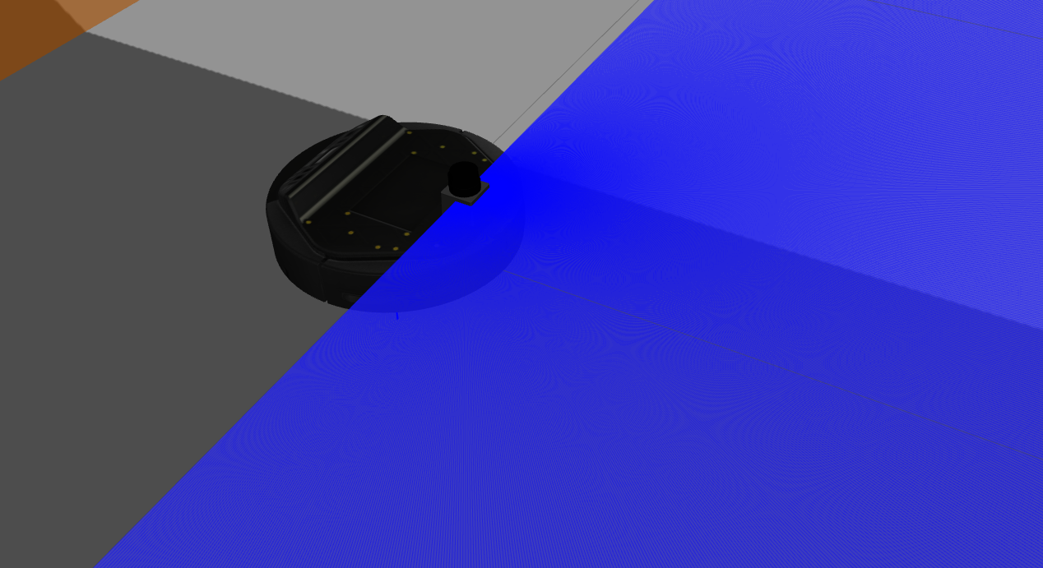
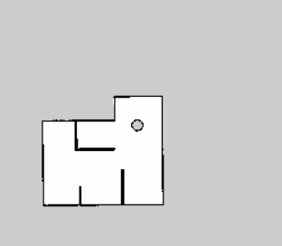
Introduction
In this project, we studied RRT, RRT* and applied the learnings on a robot by leveraging the power of simulation through ROS, Gazebo, Python and RViz.
The project was an exercise to test the concepts of RRT, RRT* and FastSLAM.

Slide 3
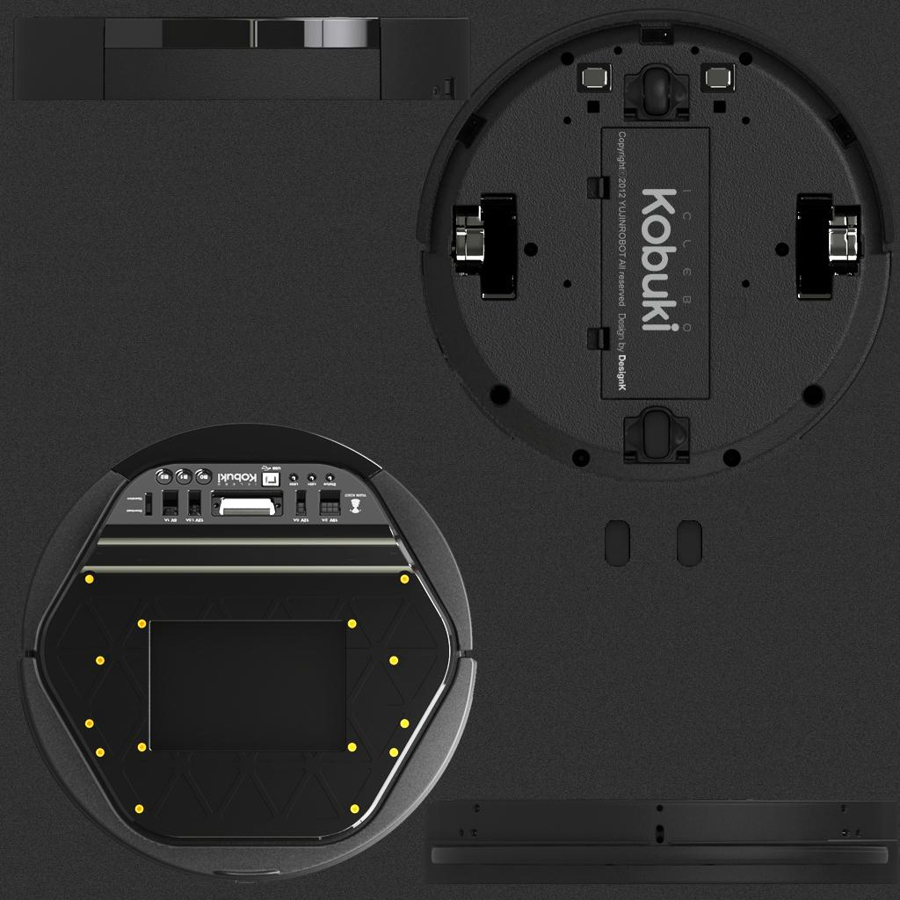
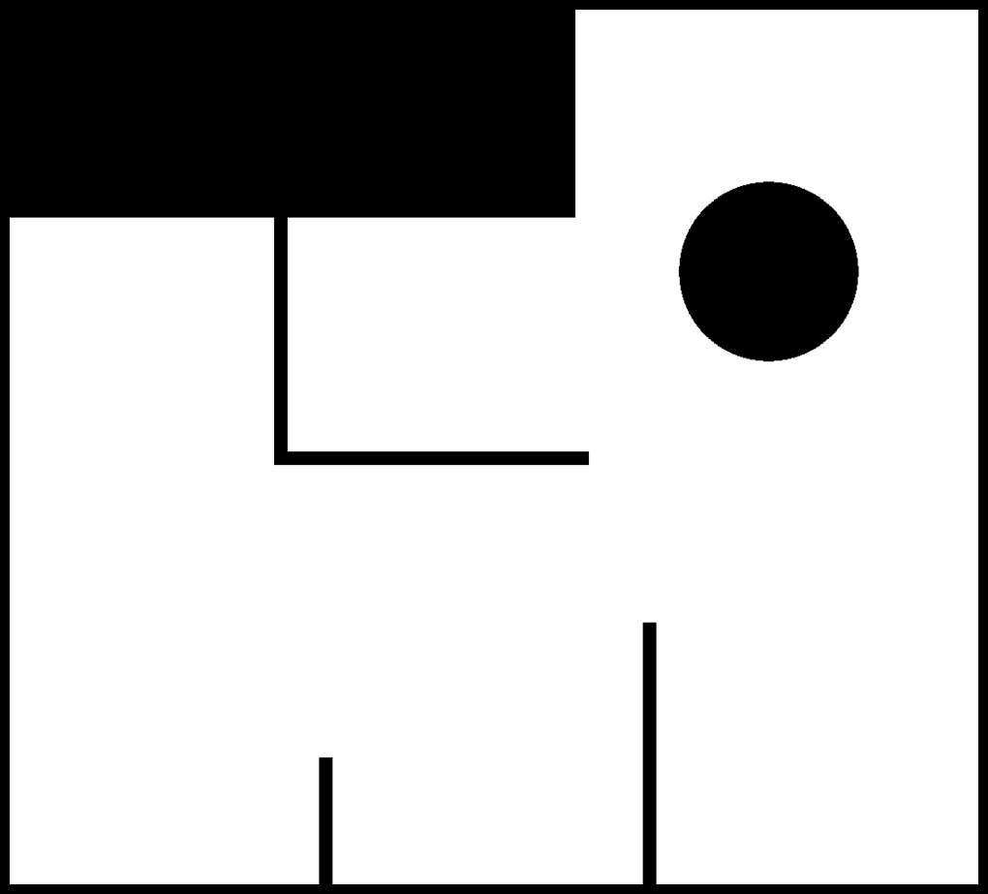
Robot and workspace
The robot that we have used is a Kobuki iCelebo, which is the base for the famous turtlebot.
The robot has a LIDAR attached to it, and is spawned in the environment.
The configuration space was defined by us, which is shown here.

Slide 4
RRT vs RRT*
Just to give you an introduction, the two algorithms have the following differences:
RRT | RRT*
Fairly Quick | Computationally expensive
Gives a longer path | Giver an optimally shorter path
Doesn’t choose the best Parent node when assigning the nearest neighbour | Chooses the best parent node in the vicinity based on the cost to come
No rewiring of neighbours | Rewire the neighbours in the vicinity if there is a shorter path based on the cost to come

Slide 5
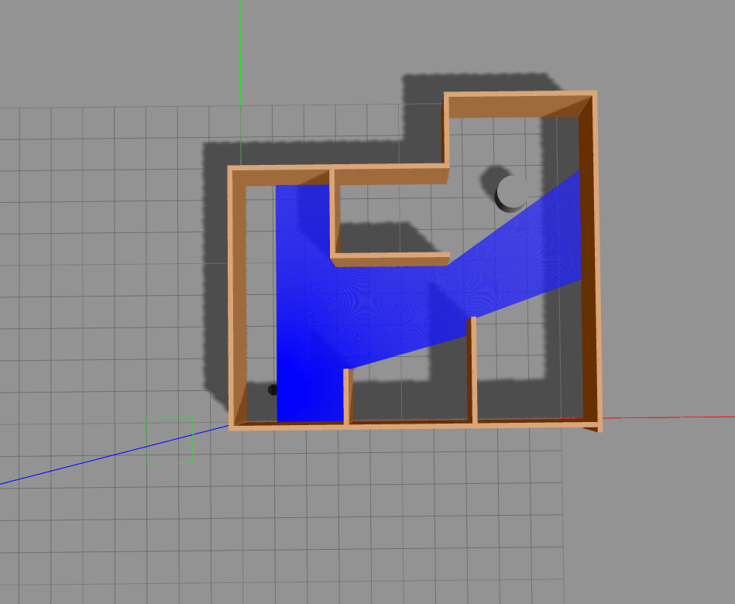
SLAM
SLAM, as we know is an acronym for Simultaneous Localization and Mapping.
The concept is vital in navigating a robot in an environment, that the robot has little to no knowledge about.
For this project, we used ROS and conducted SLAM in a custom world.
The gmapping package was used, which uses FastSLAM for this purpose.

Slide 6
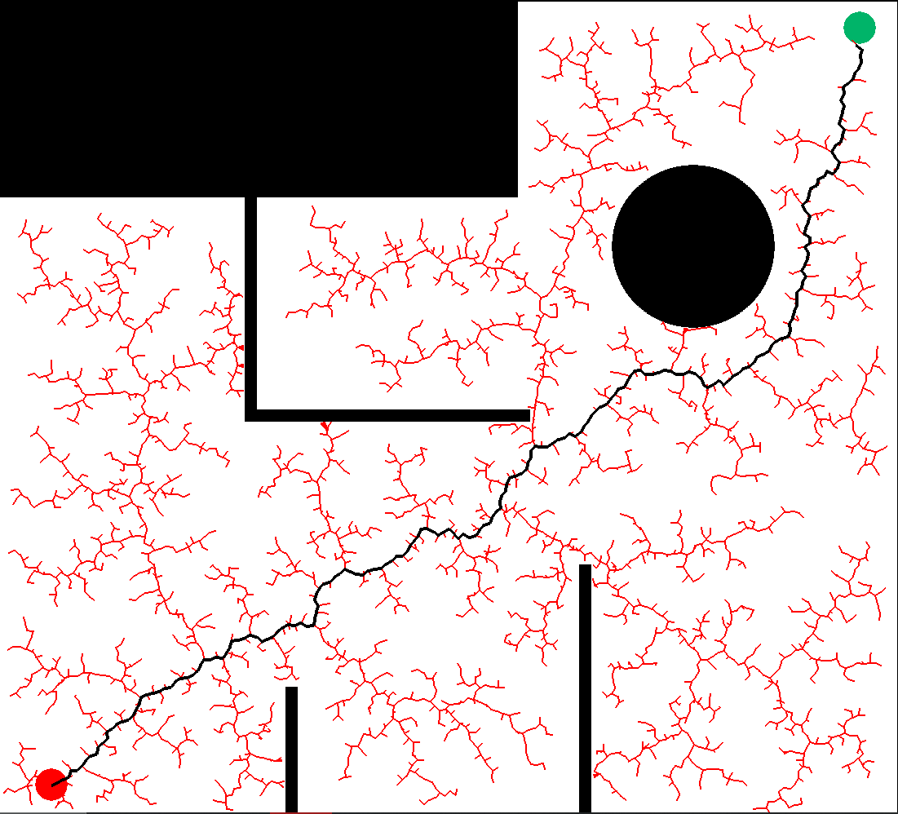
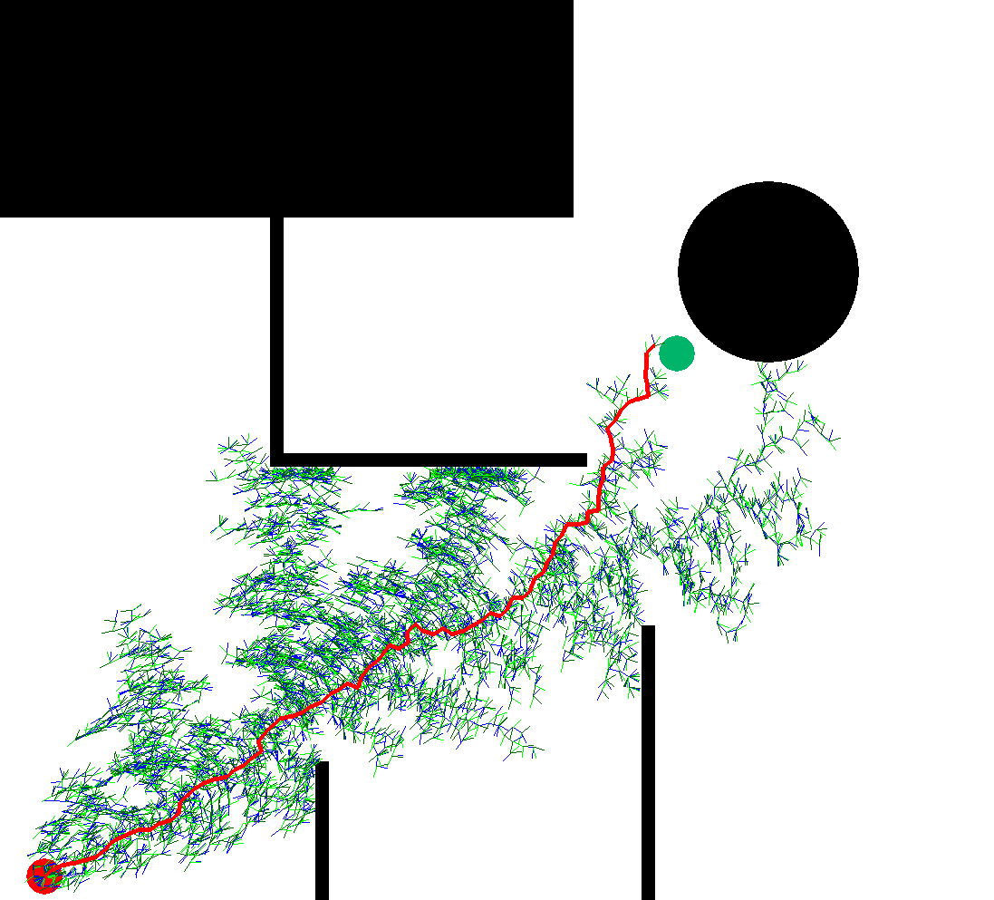
Python Simulation
We simulated RRT on Python. Simulation was done from a user defined start to a user defined goal point.
The simulation was also conducted on RRT*, just to see the differences on Python.

Slide 7
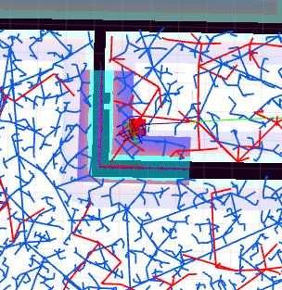
Gazebo / RViz Simulation
A kobuki robot base was spawned in the workspace on Gazebo.
The robot was fit with a LIDAR, and the path was solved using RRT.
The path that was planned can be seen on RViz.
The user can choose the start and the end.
Initially a map was generated by performing SLAM on the obstacle space, which provided with a .pgm and a .yaml file.
The map obtained after SLAM can be seen here

Slide 8
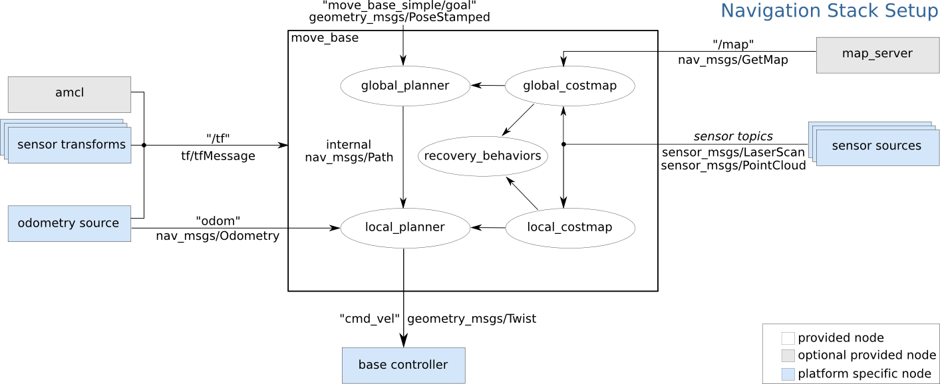

Slide 9
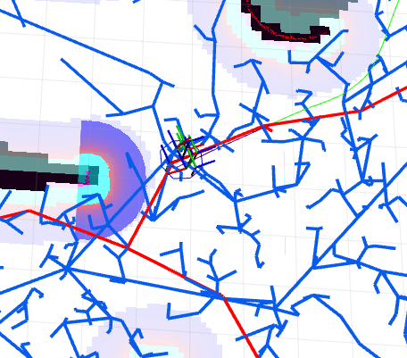
Gazebo / RViz Simulation
The robot however recalculates its position, everytime it moves across the work space.
This is done by subscribing to the /odom topic and also by taking the Laser scan data from /scan topic.
The robot also has determines its local cost map and global cost map, which is essential for the robot to know where the obstacle is with respect to itself.

Slide 10
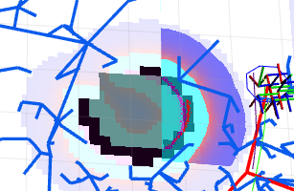
Various regions of the map
Green - Untraversable area
Black - Definitive boundaries
Vivid purple - Local cost map
Light purple - Global cost map
Red dots - LASER scan

Slide 11
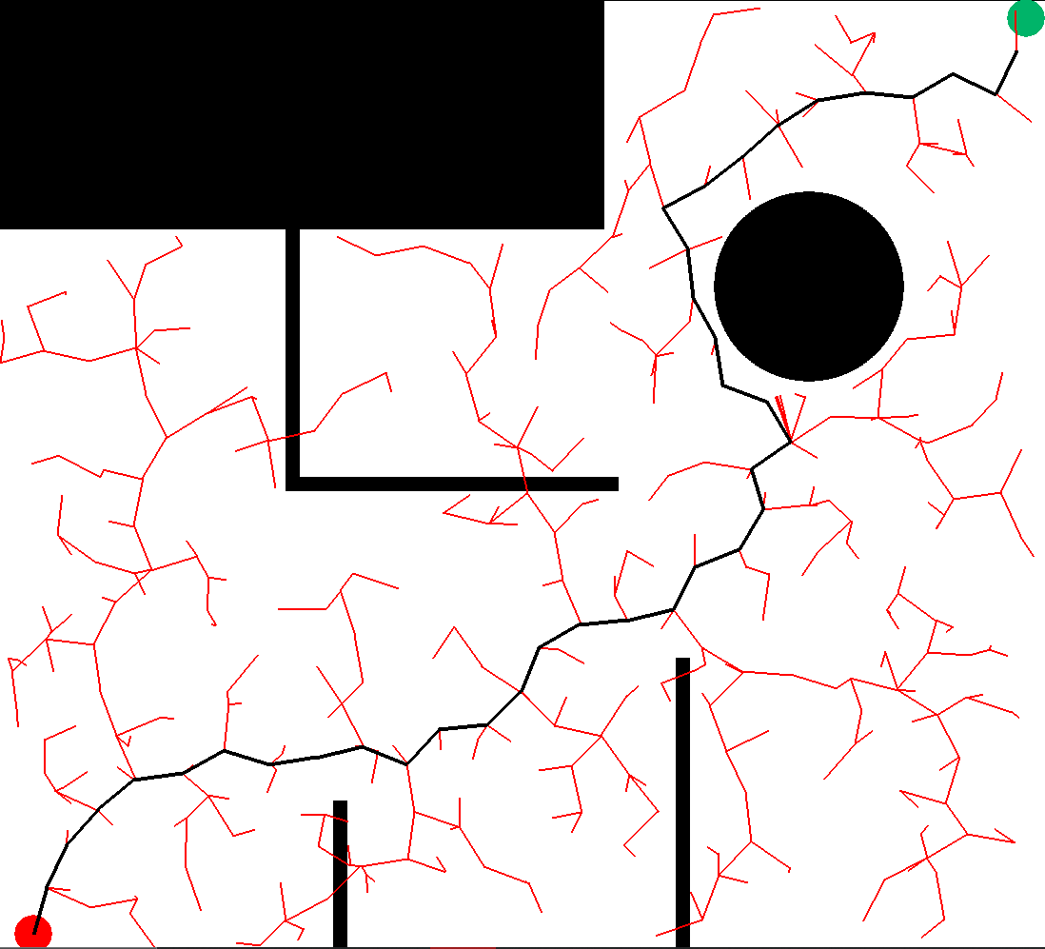
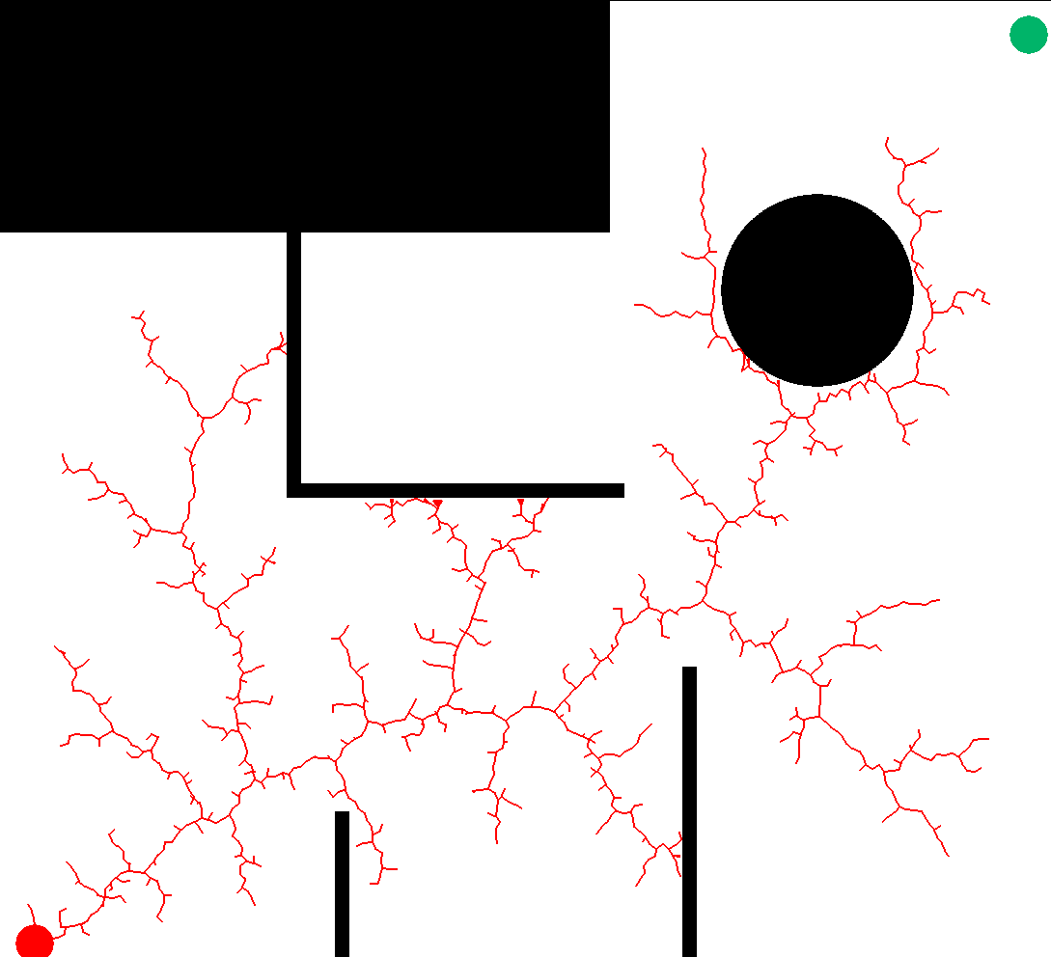
Results
RRT and RRT* simulations showed us varying results by varying the parameters for simulation. Below are the results and observations from RRT simulations on Python:
Correct delta, correct number of nodes
Large delta
Lesser number of nodes

Slide 12
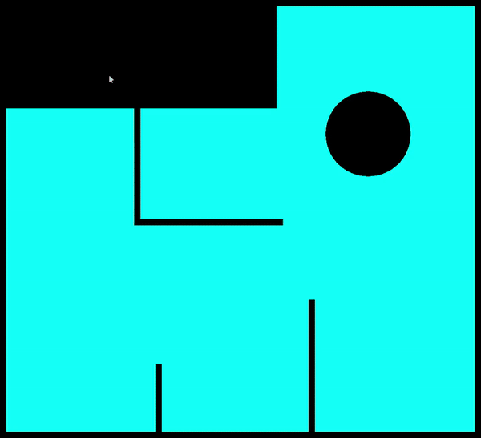

Slide 13
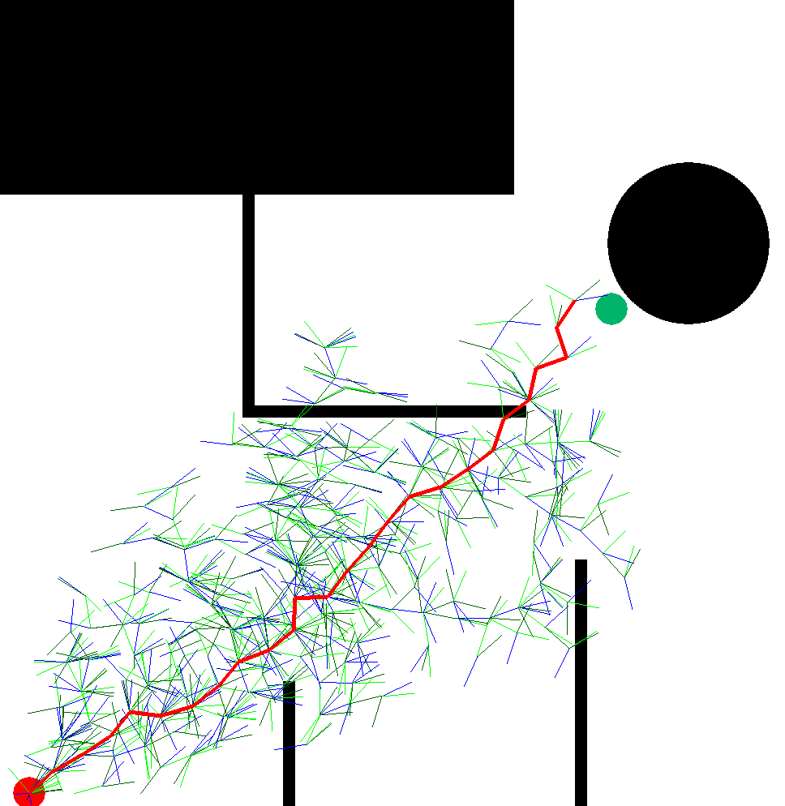
And below are the results and observations from RRT* simulations on Python:
Correct delta, correct number of nodes, BUT INCREASED TIME COMPARED TO RRT*
Wrong delta

Slide 14
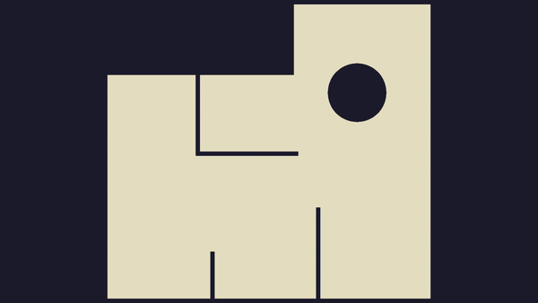

Slide 15
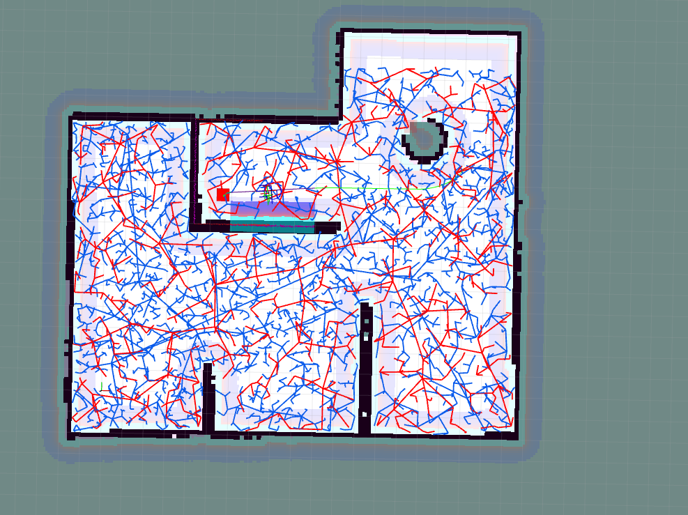
Results
The entire map was attained and perceived by the robot, without having coded the path in.
This has also validated the path predicted by the robot from the Python simulation.
The RRT* algorithm was additionally compared with RRT in the Python environment, and it was seen to provide a shorter path as the final result.

Slide 16
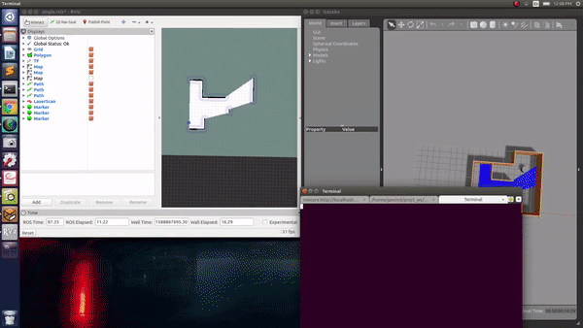

Slide 17
Conclusions
The robot’s trajectory was calculated using Python and RRT was implemented. The path was also visualized using Gazebo and RViz, using ROS. This has verified the results predicted by the path planning algorithms that was initially designed by the authors.
The advantage was also noted between RRT and RRT*, the latter of which gave the shortest path, even though it had more computational expenses.

